Slide 1
PointNet 3D Molecular structures classification
By Oren Wintner and Shay Guterman
Instructed by Dina Schneidman
The Hebrew University of Jerusalem

Slide 2
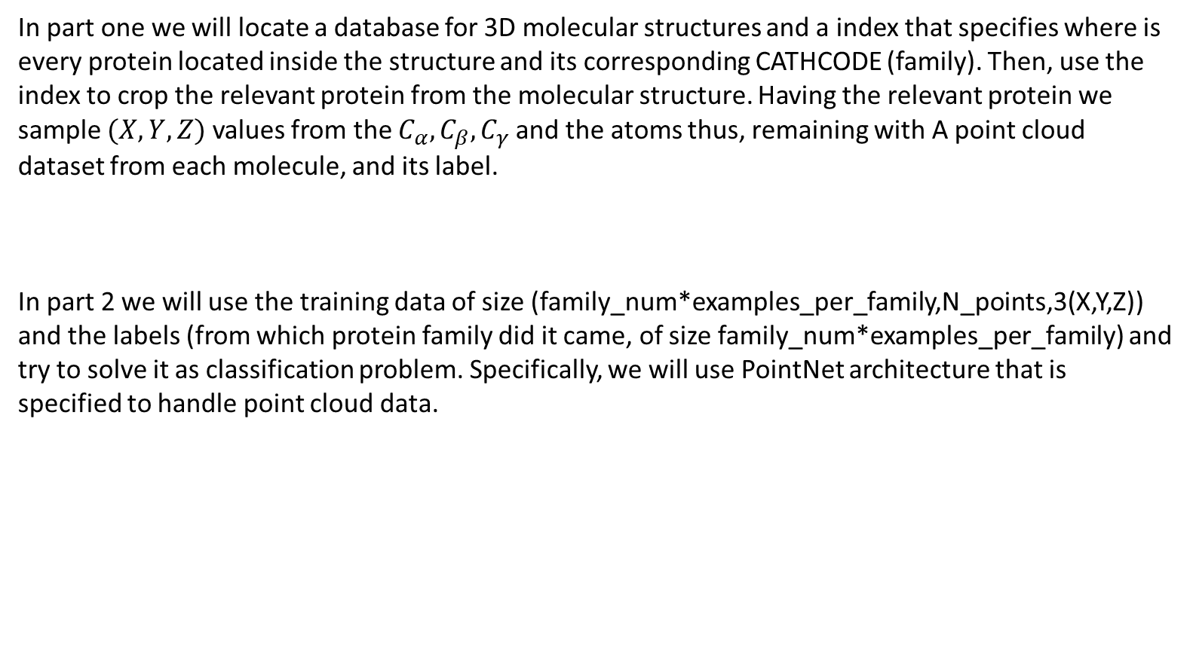
General summary
In part one we will locate a database for 3D molecular structures and a index that specifies where is every protein located inside the structure and its corresponding CATHCODE (family). Then, use the index to crop the relevant protein from the molecular structure. Having the relevant protein we sample $(X,Y,Z)$ values from the $C_{α},C_{β},C_{γ}$ and the atoms thus, remaining with A point cloud dataset from each molecule, and its label.
In part 2 we will use the training data of size (family_num*examples_per_family,N_points,3(X,Y,Z)) and the labels (from which protein family did it came, of size family_num*examples_per_family) and try to solve it as classification problem. Specifically, we will use PointNet architecture that is specified to handle point cloud data.

Slide 3
Part 1.A: From raw text files to database index
We use two text files, one holding the quantity of different protein families and the other location of the protein in the big molecule structure to create a dictionary. Said dictionary will hold the chosen families as key, and for each key the values will hold its pdb and the location inside the pdb.
Code can be found at PointNet-classification/Data prep/Part 1A - Family dict/dictionary_complete.py
Some of the text files can be found there as well

Slide 4
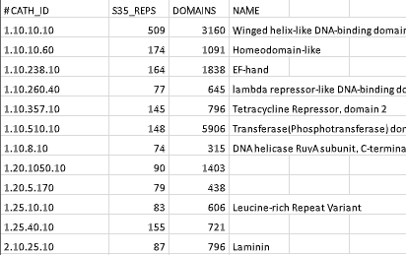
Database - PDB – Protein Data Bank
From the PDB we used https://drive.google.com/file/d/1TSNMR15zsGoey32TB_4bJ8Y06l21ajwd/view?usp=sharing
To chose which families are very evident in order to aggregate big amount of data.
CSV index example
Evident
Less evident

Slide 5
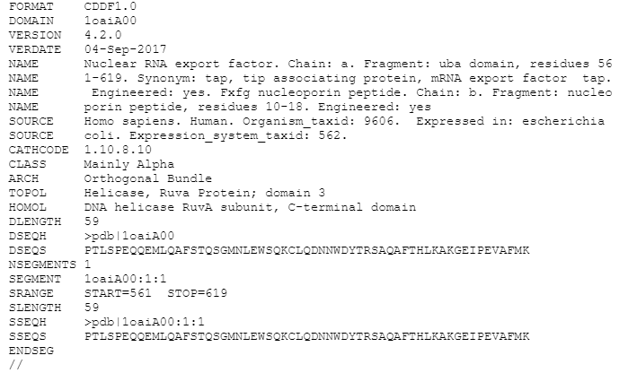
Using Families to locate PDB’s
Having the most evident protein families (CATHCODES) we can locate the relevant families, and save their DOMAIN and SRANGE. Said DOMAIN and SRANGE will be used to download and crop the relevant protein out of the larger data.
We created a dictionary where every key
is a family (CATHCODE) (‘1.10.8.10’ for example)
and has values of:
[DOMAIN, SRANGE]
One protein information
Link to small chunk of the data base
https://drive.google.com/file/d/1mIgLtHunjf_k2Asb9KSlQcjROX-Ro6GQ/view?usp=sharing

Slide 6
Part 1.B – Use dictionary to download and crop PDB’s
In part 1.A we created a dictionary that holds the most evident protein families in the Protein Data Bank (PDB) as keys, their domain name and location inside the domain as values. In this part we use the dictionary to download all of the DOMAINs, crop them using SRANGE and delete the previously downloaded PDB’s.
Code can be found at PointNet-classification/Data prep/Part 1B - Downloading PDBs/Download_chains.py
And PointNet-classification/Data prep/Part 1B - Downloading PDBs/erase_files.py

Slide 7
Part 1.B – Use dictionary to download and crop PDB’s
We use Dina’s getpdb to download PDB files from the PDB database and getchain to crop the downloaded chains.
The downloaded data weights few GB’s, ~60,000 of molecules taken from 57 well represented families. The data is ordered inside a parent folder, inside the parent folder, there are 57 folders, folder for each family. For every family, all of its cropped PDB’s are inside the folder.

Slide 8
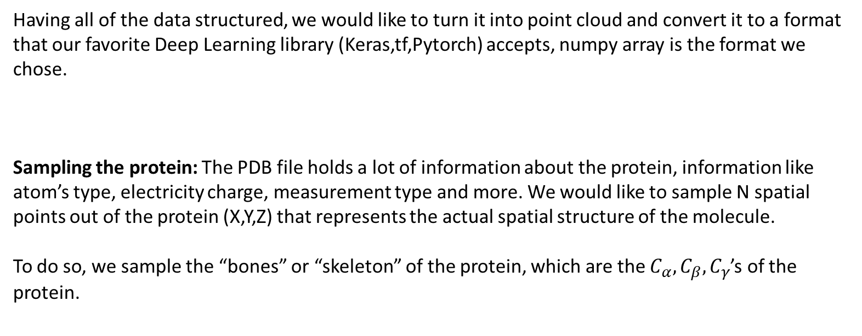
Part 1.C – From .PDB to np array
Having all of the data structured, we would like to turn it into point cloud and convert it to a format that our favorite Deep Learning library (Keras,tf,Pytorch) accepts, numpy array is the format we chose.
Sampling the protein: The PDB file holds a lot of information about the protein, information like atom’s type, electricity charge, measurement type and more. We would like to sample N spatial points out of the protein (X,Y,Z) that represents the actual spatial structure of the molecule.
To do so, we sample the “bones” or “skeleton” of the protein, which are the $C_{α},C_{β},C_{γ}$’s of the protein.
PointNet-classification/Data prep/Part 1C - PDB to np array Calpha Cbeta Cgamma / pdb_to_np_array_CA_CB_CG.py

Slide 9
Part 1.C – From .PDB to np array
Extensions and other considerations
Every family has a different number of representation (PDB files) to avoid associated biases, we chose to take 400 proteins from each family.
Every protein have a different amount of atoms, and every family of protein has a different typical size. DL standard architectures tends to work on structure of the same size. Therefore, we would like to chose the number of points (N) we take from each protein to represent accurately the larger structures, and be small enough that we can minimize the “0” padding for the smaller molecules.
We chose to sample 256 points from each molecule, and tracked the behavior by manually inspecting scatter plot of different families.

Slide 10
Part 1 summary
We started with two text files, one that holds information about the representation of the families in the data base and another that holds information regarding protein location in every molecule of the PDB (Protein Data Bank). We finished with numpy array in size (57*400,256,3) 57 families, for each family we have 400 examples, each example holds 256 points and for each point we have 3 values (X,Y,Z) and label data of size 57*400 .

Slide 11
Part 2 – Protein Point Cloud data Classification
Using the mined, labeled data, we can train a model that will try to classify unseen protein, based on learning from Point Cloud labeled data.
We used Google Colab (Jupyter notebook) as run-time environment, mostly because it’s a free, easy to use and our demands, a network with ~1M parameters and ~150MB of data, are small enough. Keras was chosen as the main DL library and PointNet as our point cloud classification model.

Slide 12
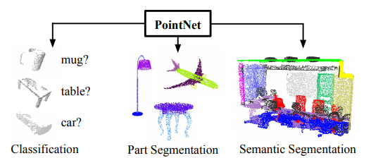
Part 2.A The model
Tried to solve the major Computer Vision tasks, Classification and Segmentation, using Point Cloud data. The main appeal is that to represent an object need small number of X,Y,Z values instead of very large images.
PointNet-classification/The model/PointNet_V3.ipynb

Slide 13
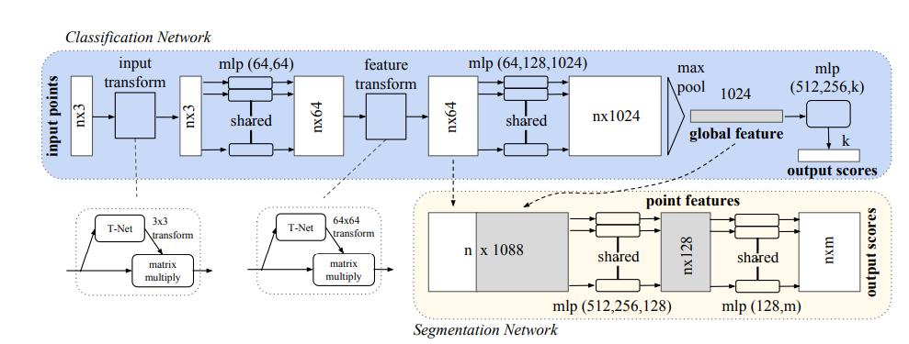
Part 2.A The model
We will use only the Classification part, thus, not implementing the segmentation part

Slide 14
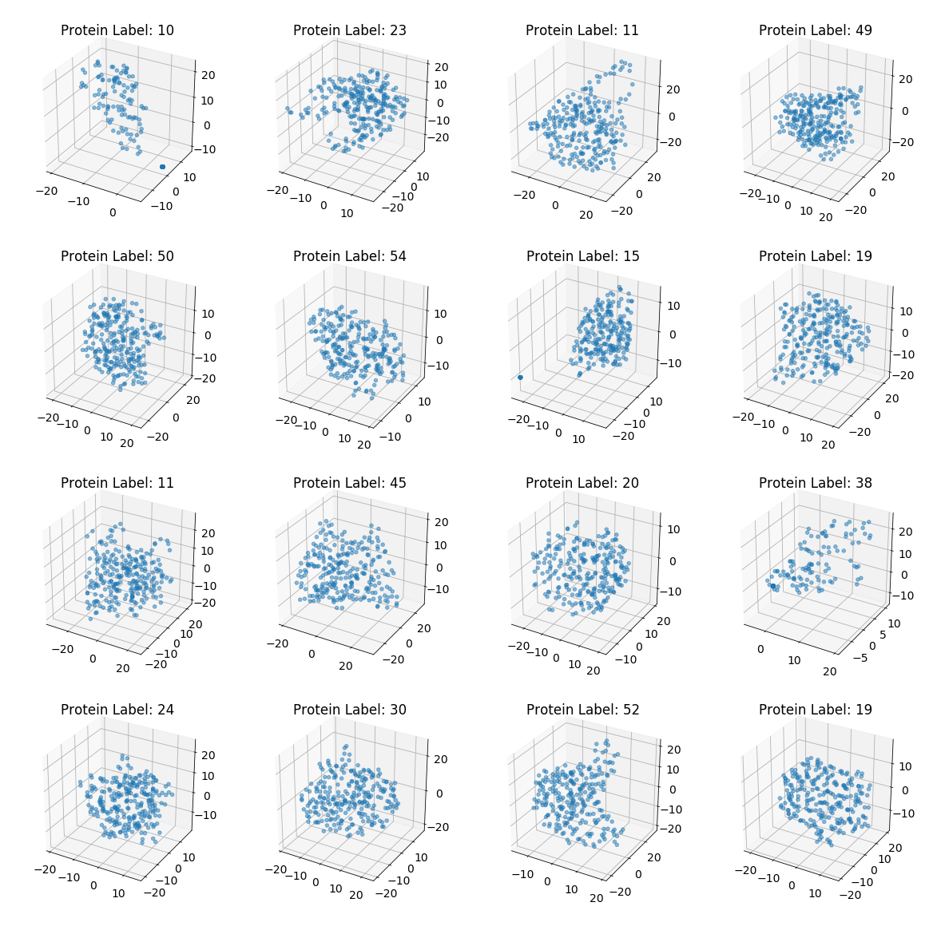
Part 2.B The data
16 examples taken directly from the raw PDBs converted to cloud points

Slide 15
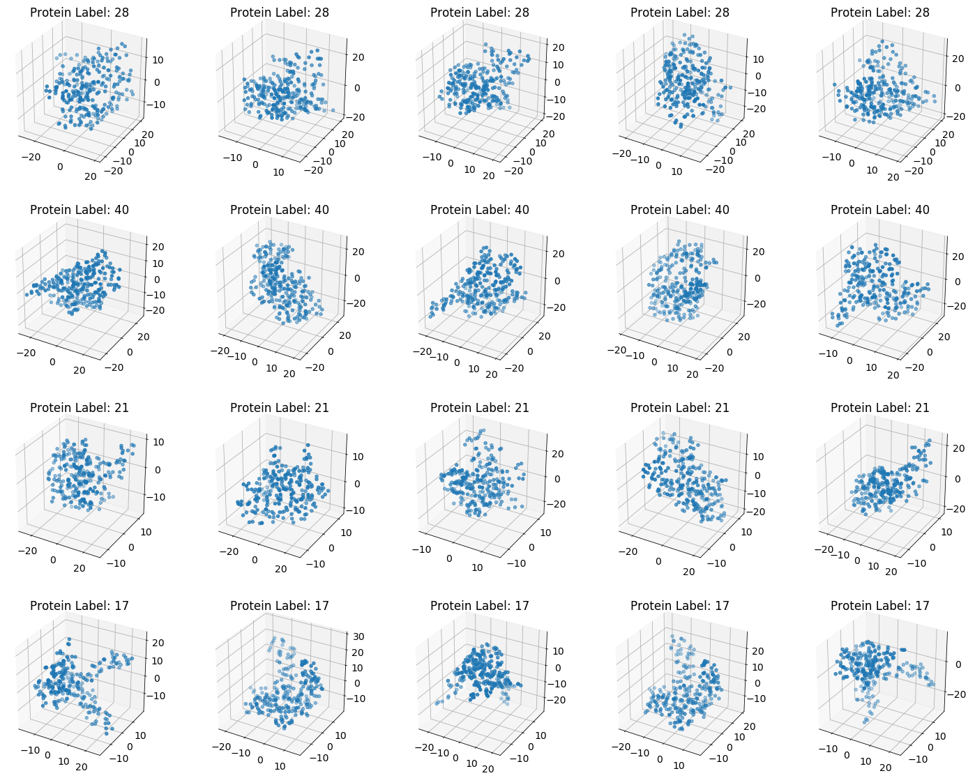
Part 2.B The data with augmentation
4 different proteins, with augmentation applied 5 different times to the same molecule.
The augmentation we used is to add small jitter to each point in the cloud and random rotation of the protein in the 3D space. The jitter represents small inaccuracies in the measurement and the rotation is applied to account for the different positions the protein can be arranged on the surface.

Slide 16
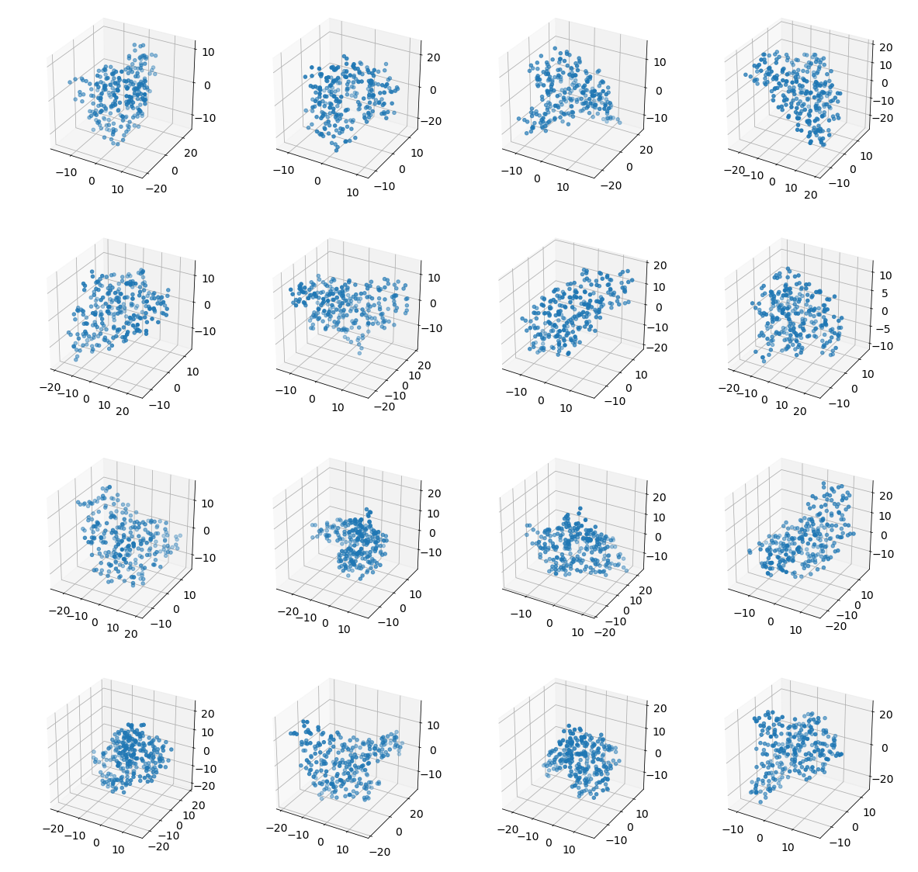
Part 2.B The data with augmentation
16 different protein with augmentations, taken from the same family. Our model need to classify all the structures to the same label.

Slide 17
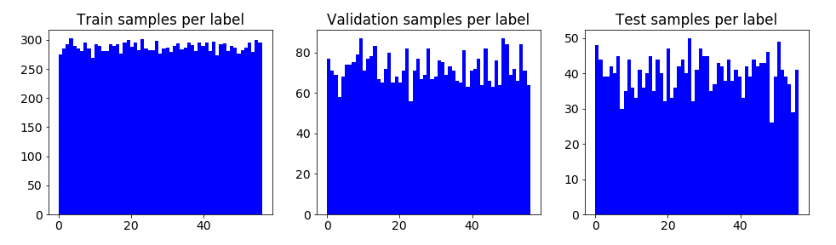
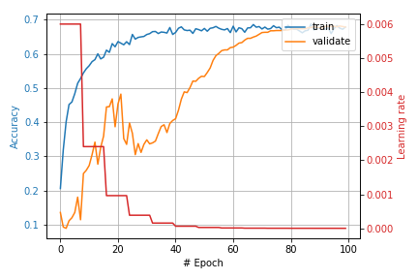
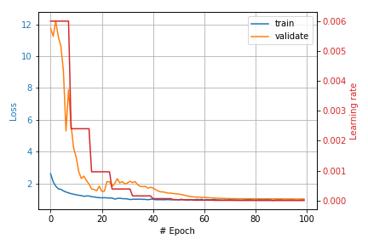
Part 2.C Training the model
In order to make the model converge, we adjusted the dropout, pushed each protein to be centered around zero, zero padded missing values, tuned the augmentation changed some hyper parameters alongside introduction of learning rate plan.
Accuracy and loss during train

Slide 18
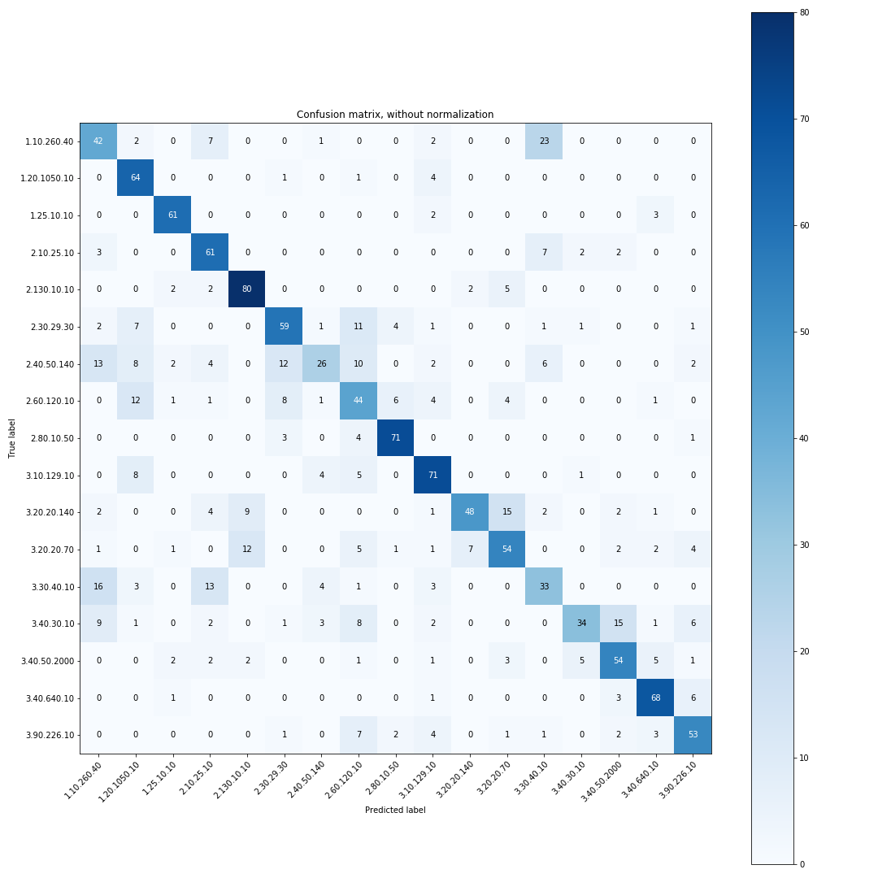
Part 2.D Results
The confusion matrix of 17 families with ~64% accuracy on the first seen test set. We took a subset of the families to compensate for their spatial resemblance between close families (for example 2.30.29.30 is close to 2.30.29.60)

Slide 19
Part 3.A – PDB alignment
To achieve better classification accuracy we tried to align the proteins using classic alignment algorithms. The alignment was done for each family, we aligned all of the proteins according to the first protein in the folder. Having an aligned data-base we can compare it to the previous one.
Our conjecture, is that the first part of PointNet, where the network tries to find the rotation of the point cloud isn’t sufficient.
PointNet-classification/The model with alignment/align_pdbs.py

Slide 20
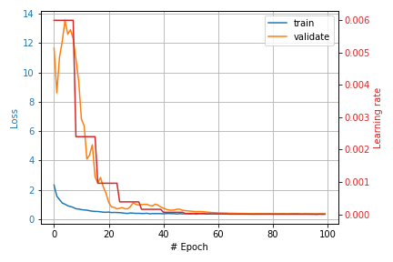
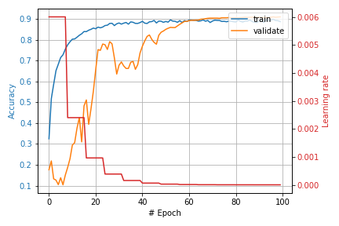
Part 3.B – The model with aligned PDB’s.
We had two options, to feed the network the new aligned data as is, or to delete the part of the network that governs the rotation of the point cloud data. We ended up choosing the first.

Slide 21
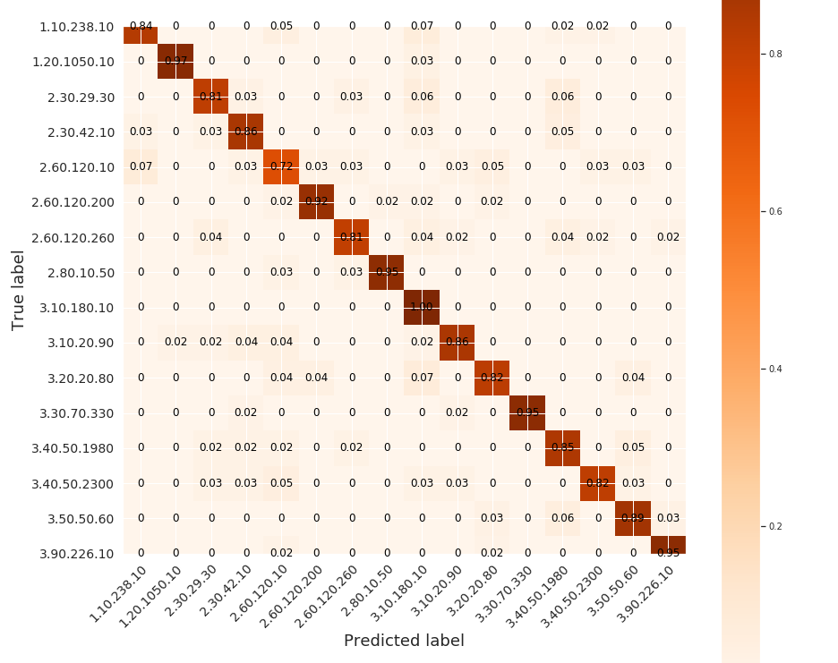
Part 3.C – Results with aligned PDB’s.
The results dramatically improved using the aligned proteins. The confusion matrix is normalized that each number represents the total accurate classification of the true label.

Slide 22
Summary and conclusion
In this project we tried to use spatial information in the form of point cloud (X,Y,Z values) in order to classify proteins to families. We mined the data from the PDB and pre-processed it, later The data was fed to a neural network that we tailored for our problem.
Although our first attempts were far from producing state of the art results (67% true classification at best), the fact that the network was able to train and learn from the spatial information was encouraging. From the results using alignment, we learn that PointNet doesn’t find the optimal rotation for the point cloud in the beginning of the network.

Slide 23
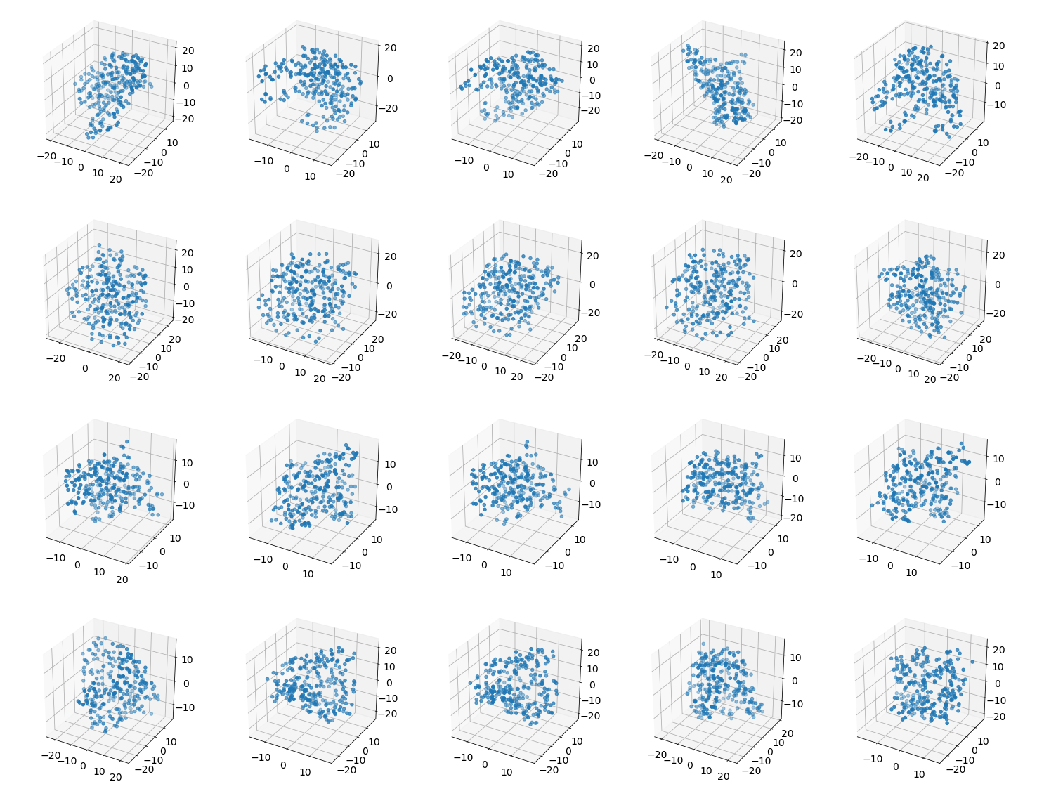
Point cloud data for Protein families
Label (family)
1
2
3
4
5 protein examples for 4 family types

